Slide 1

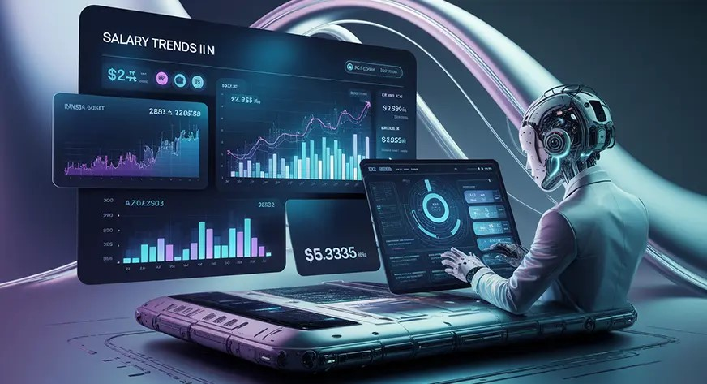
Title of the Project
Salary Prediction using linear regression
“Predict Pay, Plan Your Future”
-By TANISHA DAS
-Guided by:Ms.Naina Devi

Slide 2

Project Description
The aim of this project is to predict employee salaries based on factors like job title, experience, education, and location.
Helps in salary benchmarking for companies and job seekers.

Slide 3

Dataset
Source: Kaggle Dataset (Employee Salaries)
Features: Job title, experience, education level, company size, location
Target: Salary
Preprocessing: Missing values handled, categorical encoding, normalization

Slide 4









Tools and Technologies
Python – Programming Language
Jupyter Notebook – Model Building Analysis
Streamlit – Web App Deployment
Kaggle – Data Source
Libraries: pandas, numpy, scikit-learn, matplotlib, seaborn, streamlit

Slide 5

Machine Learning Models Used
Linear Regression
Random Forest Regressor
Gradient Boosting Regressor
Voting Regressor (Ensemble Model)
Ensemble approach improved overall accuracy

Slide 6

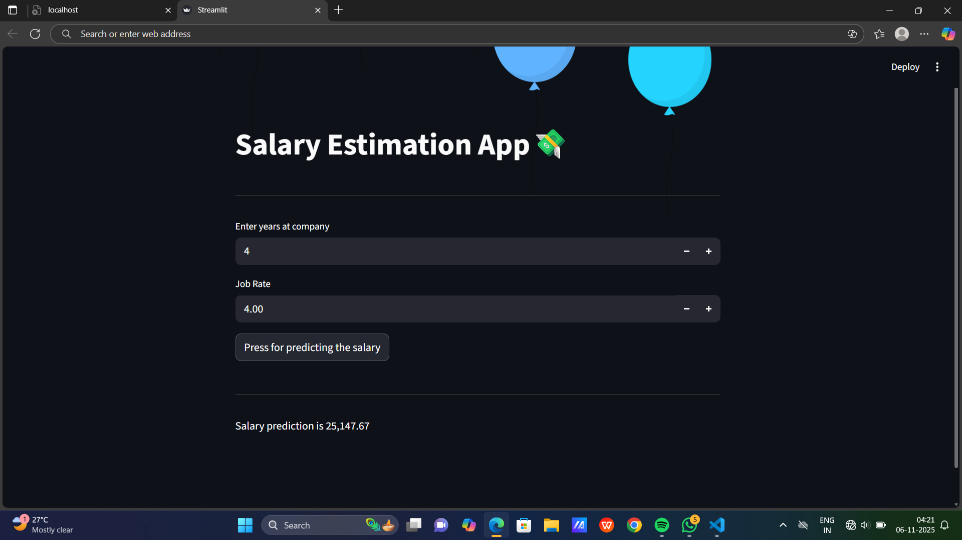
DEMO
Features:
User input for job title, experience, education, location
Predicts expected salary instantly
Interactive and easy
to use
LINK: 👇
https://screenapp.io/app/v/VEop7tT4D-

Slide 7
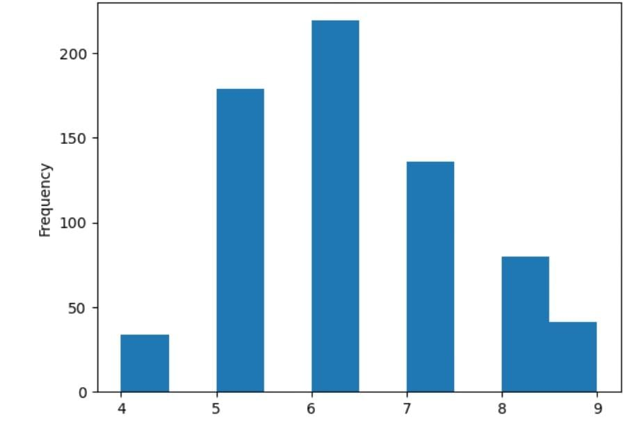
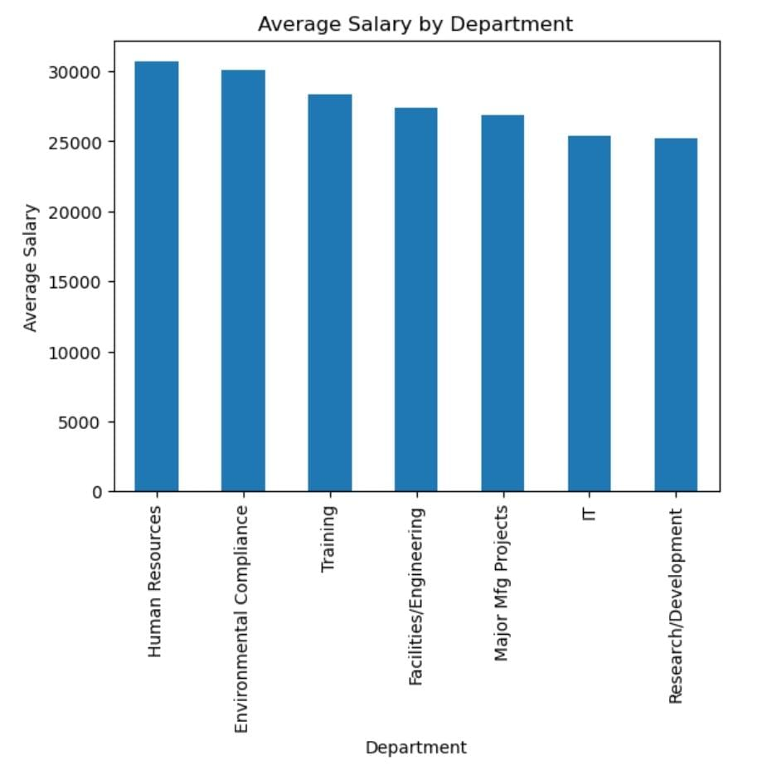
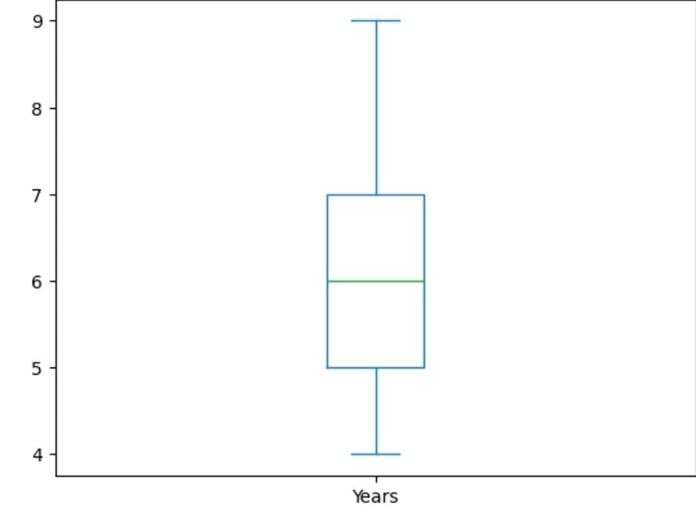
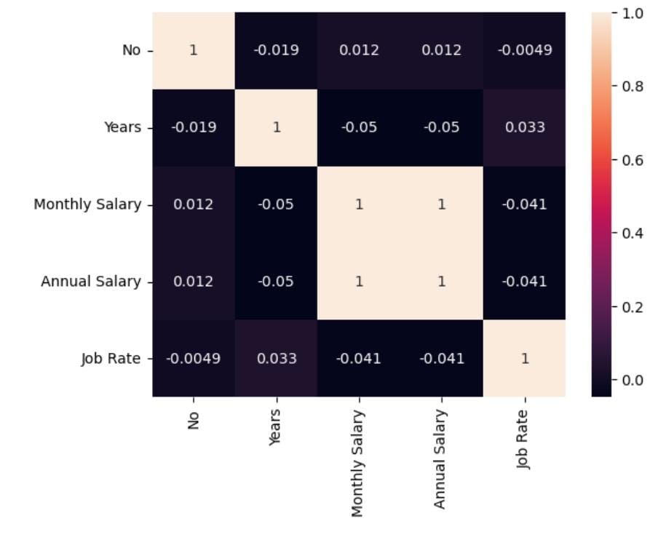
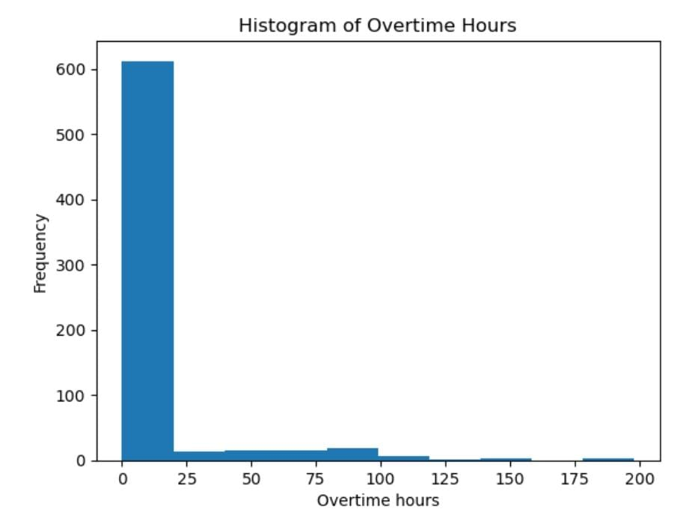
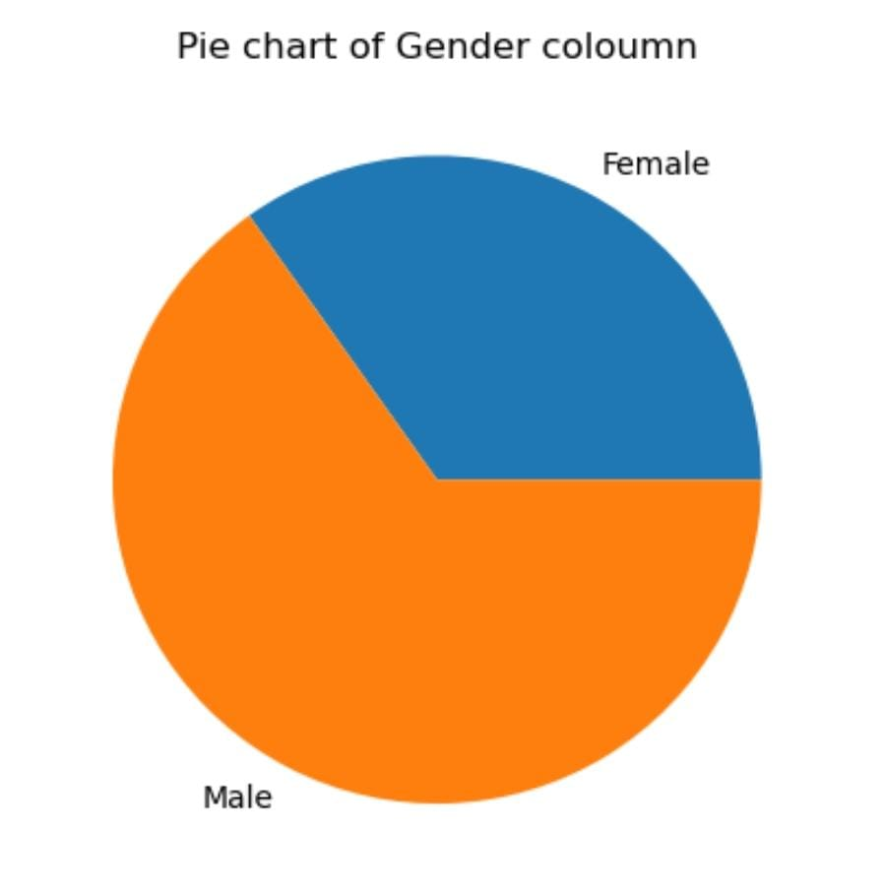
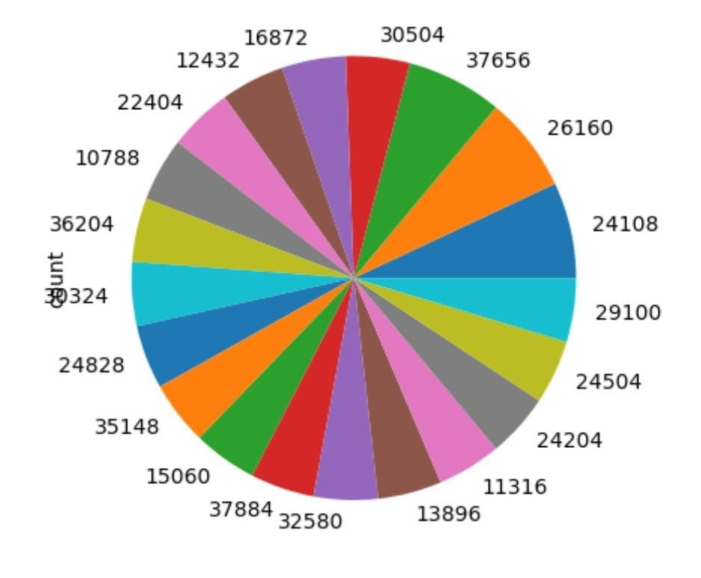
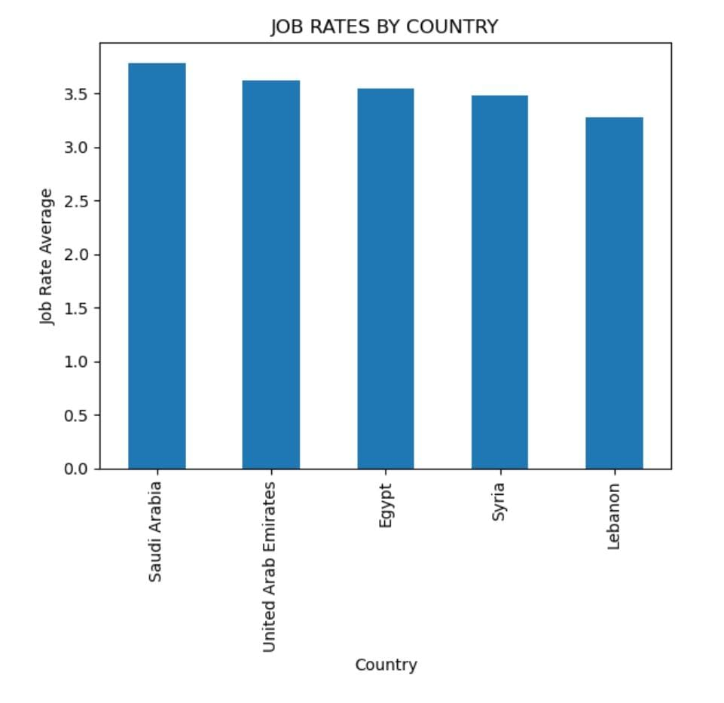
Screenshot of Data visialization: key factor
Data visualization helps in identifying patterns and trends in the data.
We used plots to display the relationship between different features and salary
Bar Chart: Mean Salary by Education Level or Job Title.
Histogram/Box Plot: Distribution of salaries or age groups.
Pie chart: A pie chart showing the breakdown of employees.Provides a clear view of the composition of the workforce within the data.

Slide 8

Applications
For Job Seekers: Estimate fair salary expectations
For Employers: Assist in deciding compensation offers
For Analysts: Study salary trends across industries
For Researchers: Understand salary determinants

Slide 9

Issues Faced
Missing and inconsistent data in dataset
Imbalanced salary data distribution
Feature encoding for categorical variables
Streamlit UI not displaying model outputs properly.

Slide 10

How Issues Were Overcome
Handled missing values using mean/median imputation.
Applied log transformation for salary normalization.
Used LabelEncoder and OneHotEncoder for categorical data.
Debugged Streamlit app for correct model predictions.

Slide 11

Future Enhancements
Integrate real-time data from job portals.
Add interactive dashboards.
Implement deep learning models for better accuracy.

Slide 12

Results & Conclusion
Improved accuracy using ensemble models
Model provides reliable salary estimates
Successfully deployed on Streamlit

Slide 13
THANK YOU...!!

